Slide 1


Slide 2
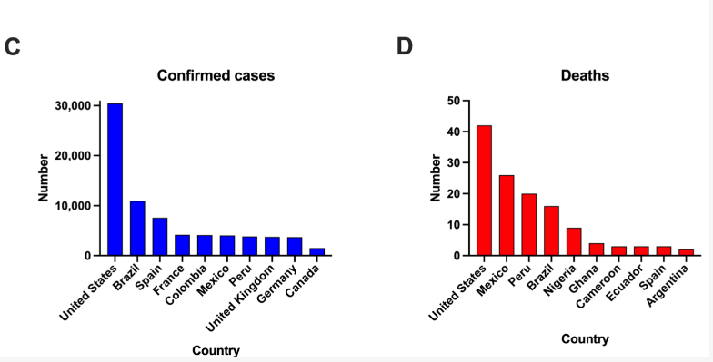
North-South Disparities in Mortality

Slide 3


Slide 4


Effect of quarantine on Mpox infection dynamics
Proscovia Nakasujja
Muwanga Edrisa
Gebiyau
Kenneth Enwerem
Notes:
Welcome to this presentation on the crucial role quarantine plays in managing the spread of Mpox. Today, we will explore how quarantine as a public health intervention impacts the dynamics of Mpox infections, with a focus on transmission rates, case numbers, and containment strategies. Through collaborations between the Kwame Nkrumah University of Science and Technology (KNUST) and the German-West African Centre for Global Health and Pandemic Prevention (G-WAC), this research seeks to contribute valuable insights into optimizing outbreak responses in West Africa and beyond. Let’s dive deeper into how quarantine measures can alter the course of an outbreak and save lives."

Slide 5
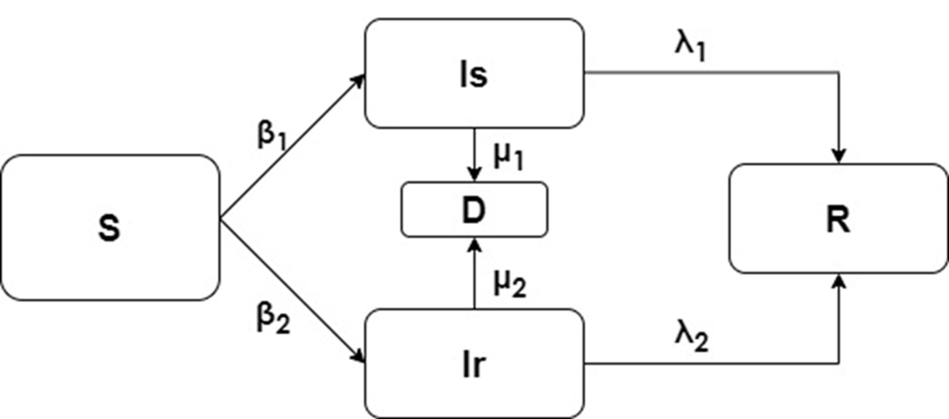

Model compartments

Slide 6

Parameters and Initial State Conditions
State | Definition | Value/week | Source
S0 | Susceptible population at time 0 | 99000000 | Estimated
Is0 | Infected population due to sexual contact at time 0 | 2217 | Estimated
Ir0 | Infected population due to direct contact at time 0 | 22226 | Estimated
D0 | Dead population at time 0 | 2 | Estimated
R0 | Recovery population at time 0 | 0 | Estimated
β1 | Infection rate from sexual contact | 0.1 | Estimated
Β2 | Infection rate from direct contact | 0.019 | Estimated
λ1 | Recovery rate from infection due to sexual contact | 0.0247 | Bhunu & Mushayabasa 2011
Λ2 | Recovery rate from infection due to direct contact | 0.0247 | Bhunu & Mushayabasa 2011
µ1 | Death from infection due to sexual contact | 0.0028 | Bhunu & Mushayabasa 2011
µ2 | Death from infection due to direct contact | 0.0028 | Bhunu & Mushayabasa 2011

Slide 7

Differential equations (1)
dS/dt = - (β1Is + β2Ir)S/N (1)
dIs/dt = β1IsS/N – (λ1 + µ1)Is (2)
dIr/dt = β2IrS/N – (λ2 + µ2)Ir (3)
dD/dt = µ1Is + µ2Ir (4)
dR/dt = λ1Is + λ2Ir (5)

Slide 8
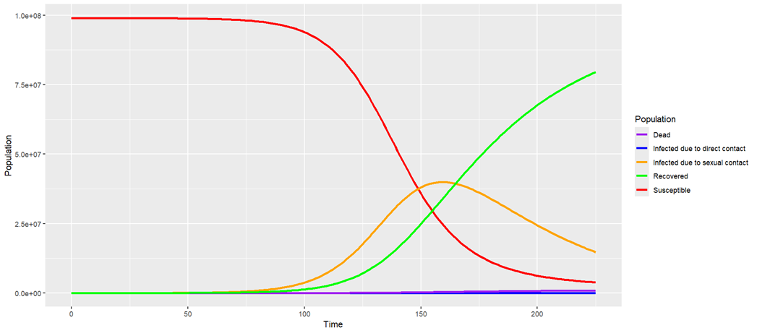
Model simulation

Slide 9
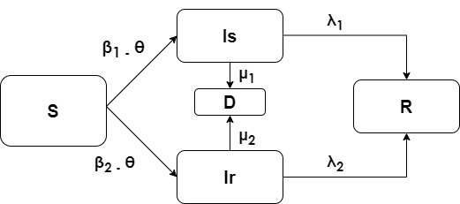
Model compartment with quarantine introduced

Slide 10
Differential equations (2)
dS/dt = - ((β1-θ)Is + (β2-θ)Ir)S/N (1)
dIs/dt = (β1-θ)IsS/N – (λ1 + µ1)Is (2)
dIr/dt = (β2-θ)IrS/N – (λ2 + µ2)Ir (3)
dD/dt = µ1Is + µ2Ir (4)
dR/dt = λ1Is + λ2Ir (5)

Slide 11
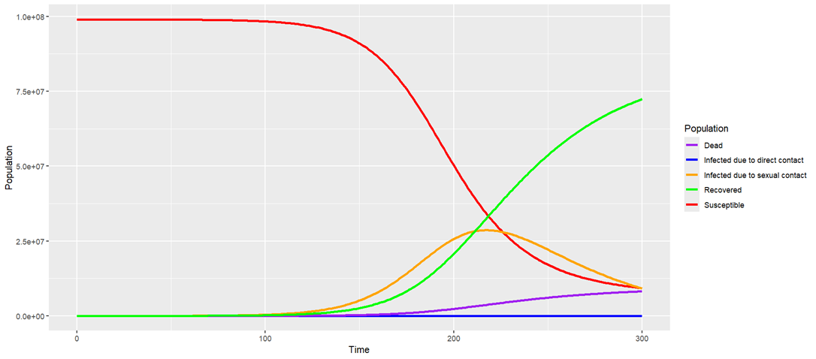
Effect of quarantine on Mpox infection dynamics

Slide 12
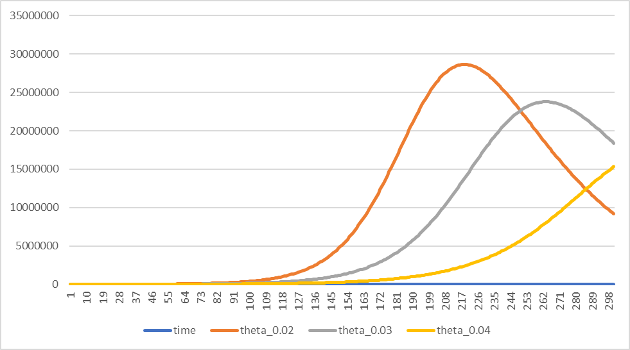
Scenario analysis showing effect of different quarantine rates

Slide 13


Slide 14
